Slide 1


PREDICTIVE HEALTH: ML FOR DISEASE DIAGNOSIS
RAMPRAKASH L
PRAVINESH H

Slide 2

ABSTRACT
DISEASE PREDICTION USING MACHINE LEARNING IS THE SYSTEM THAT IS USED TO PREDICT THE DISEASES FROM THE SYMPTOMS WHICH ARE GIVEN BY PATIENTS OR ANY OTHER USER. THE SYSTEM PROCESSES THE SYMPTOMS PROVIDED BY THE USER AS INPUT AND GIVES THE OUTPUT AS THE PROBABILITY OF THE DISEASE. NAIVE BAYES, KNN, DECISION TREE, RANDOM FOREST CLASSIFIERS IS USED IN THE PREDICTION OF THE DISEASE WHICH IS SUPERVISED MACHINE LEARNING ALGORITHM. WITH AN INCREASE IN BIOMEDICAL AND HEALTHCARE DATA, ACCURATE ANALYSIS OF MEDICAL DATA BENEFITS EARLY DISEASE DETECTION AND PATIENT HEALTHCARE.

Slide 3
EXISITING SYSTEM
disease diagnosis often relies on manual analysis by medical professionals, which can be time-consuming and prone to human error. The existing methods for disease prediction typically include:
Manual Diagnosis
Standardized Tests
Basic Decision Support Systems
Limited Data Utilization

Slide 4
PROPOSED SYSTEM
Automated Disease Prediction: The system uses machine learning algorithms such as Naive Bayes, K-Nearest Neighbors (KNN), Decision Trees, and Random Forests to predict diseases based on input symptoms provided by user
Feature Selection and Optimization: Advanced data mining techniques, including recursive feature elimination, are used to identify and select the most relevant features from medical datasets, improving model accuracy and efficiency.
Early Detection and Improved Patient Care: By providing accurate and timely disease predictions, the system enhances early detection of diseases, allowing for prompt medical intervention and better patient outcomes.

Slide 5
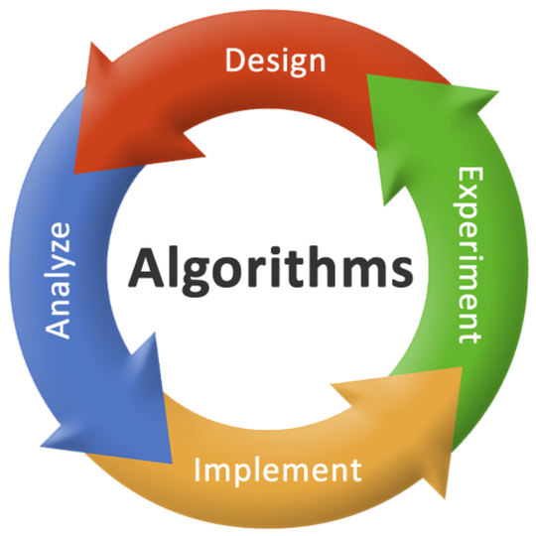
DECISION TREE: Decision Trees split data into subsets based on the value of input features, creating a tree-like model of decisions
K NEAREST NEIGHBOR:KNN is a non-parametric, instance-based learning algorithm. It classifies data based on the majority class among the k-nearest neighbors
NAIVE BAYES:Suitable for medical diagnosis due to its simplicity and speed, providing a good baseline for comparison with more complex algorithms
RANDOM FOREST:Random Forest is an ensemble learning method that constructs multiple decision trees and merges their outputs to improve accuracy and control over-fitting

Slide 6
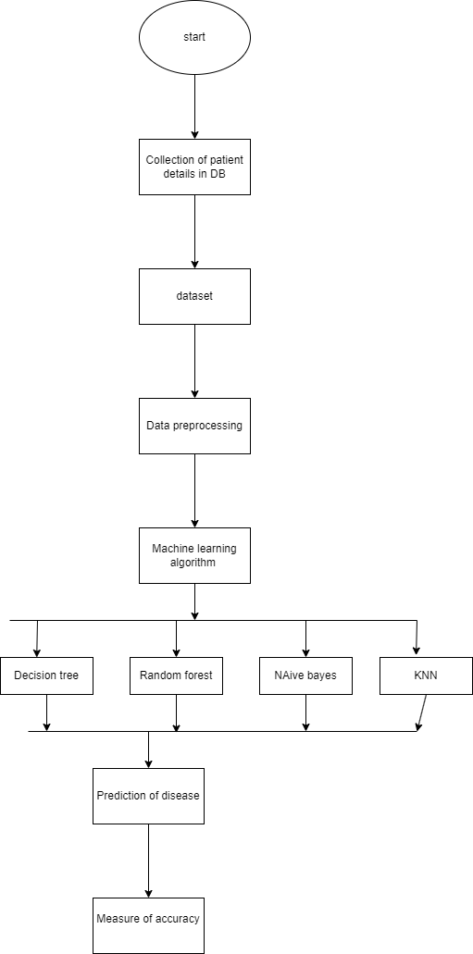
ARCHITECTURE DIAGRAM

Slide 7
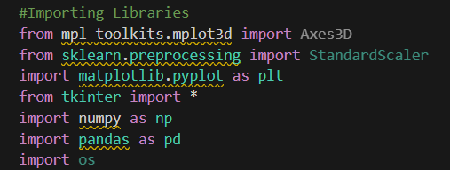
LIBRARIES INCLUDED

Slide 8
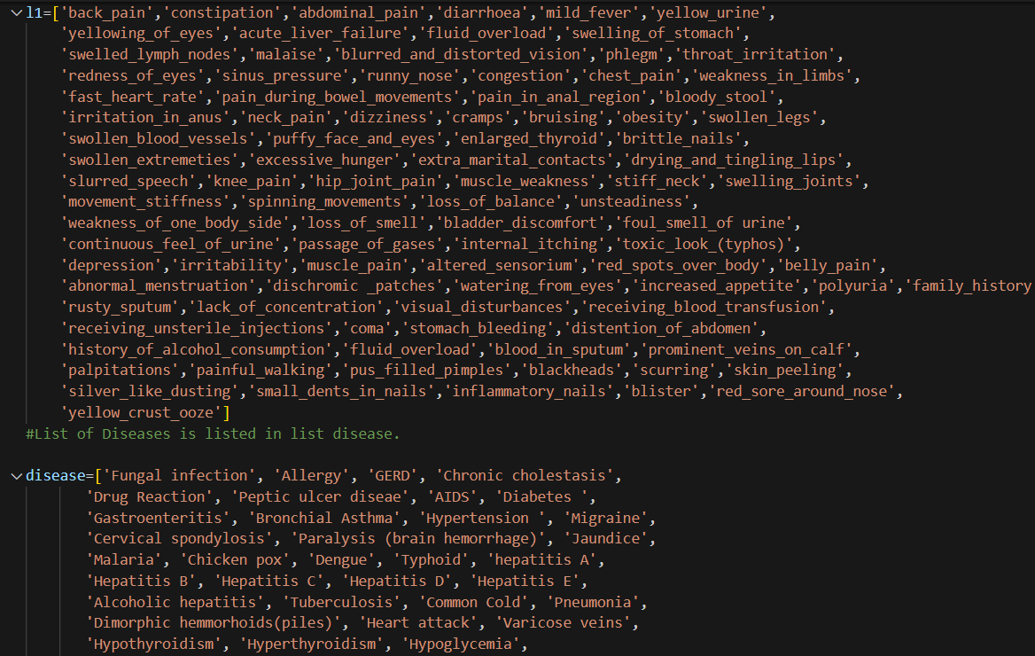
SAMPLE DATASET

Slide 9
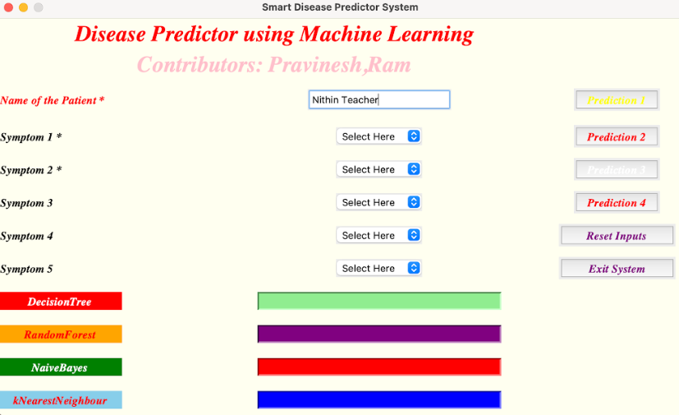
OUTPUT

Slide 10
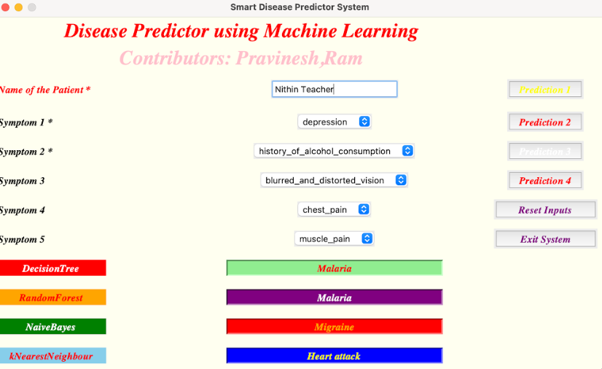
OUTPUT

Slide 11
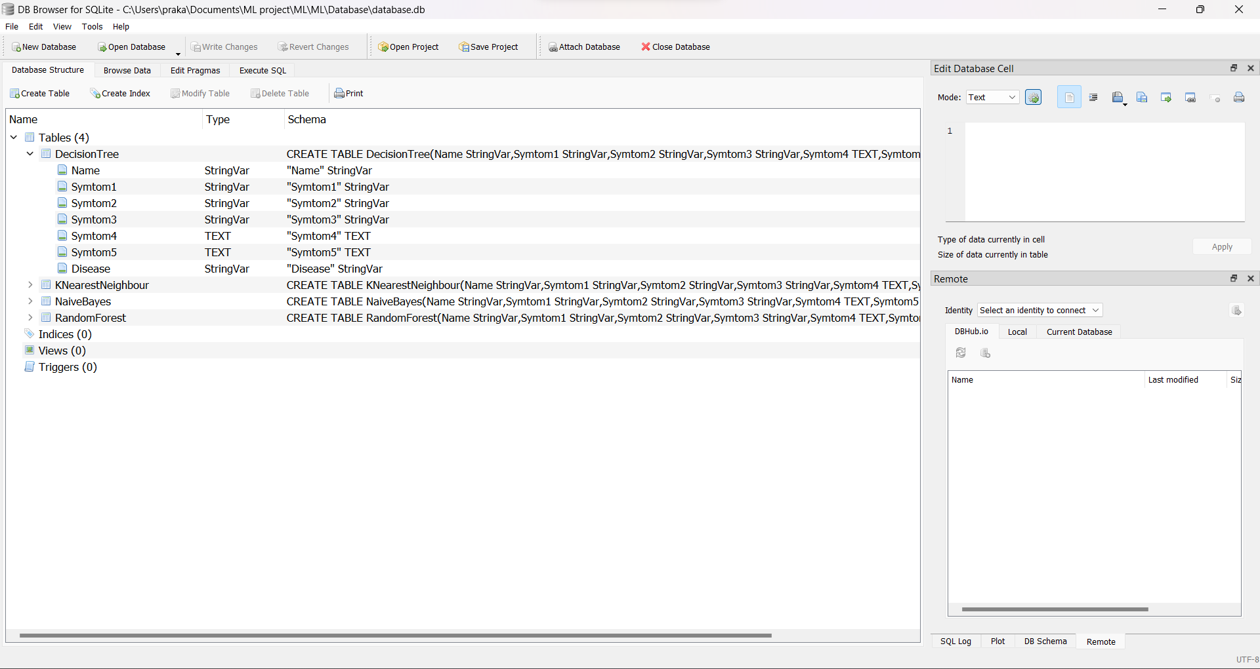
DATABASE

Slide 12


THANKYOU

